Slide 1
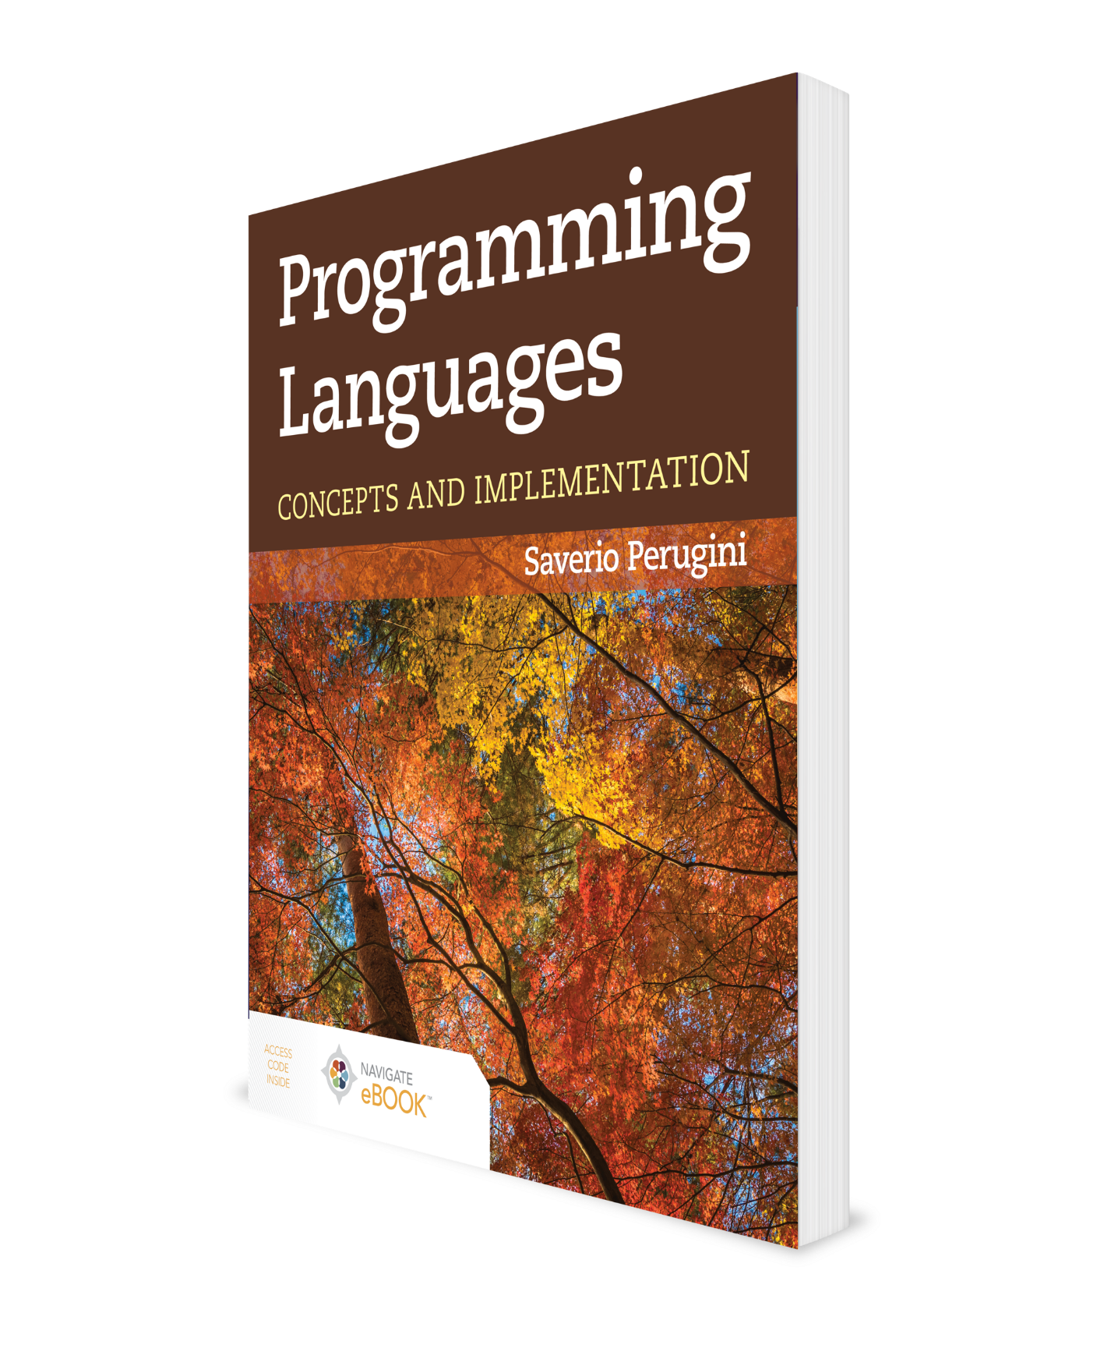
Functional Programming in Scheme
CHAPTER 5

Slide 2
Chapter 5: Functional Programming in Scheme
[L]earning Lisp will teach you more than just a new language—it will teach you new and more powerful ways of thinking about programs.
— Paul Graham
A programming language that doesn’t change how you think about programming isn’t worth knowing.
-- Alan Perlis
Functional programs operate by returning values rather than modifying variables—which is how imperative programs work.

Slide 3
5.1 Chapter Objectives
Foster a recursive-thought process toward program design and implementation.
Understand the fundamental tenets of functional programming for practical purposes.
Explore techniques to improve the efficiency of functional programs.
Demonstrate by example the ease with which data structures and programming abstractions are constructed in functional programming.
Establish an understanding of programming in Scheme.
Your text uses Scheme; we’re using Racket for this course. What’s the difference?
Very little. Scheme code will usually run without modification as Racket code.
Racket has some additional features added.

Slide 4
5.2.1 Hallmarks of Functional Programming
Functions are first-class entities.
Often use higher-order functions (functions that return functions) to build abstraction.
Recursion, rather than iteration, is the primary mechanism for repetition.
No or little provision for side effects
Typically use automatic garbage collection
Usually do not involve direct manipulation of pointers by the programmer
Historically, considered languages for artificial intelligence, but this is no longer the case

Slide 5
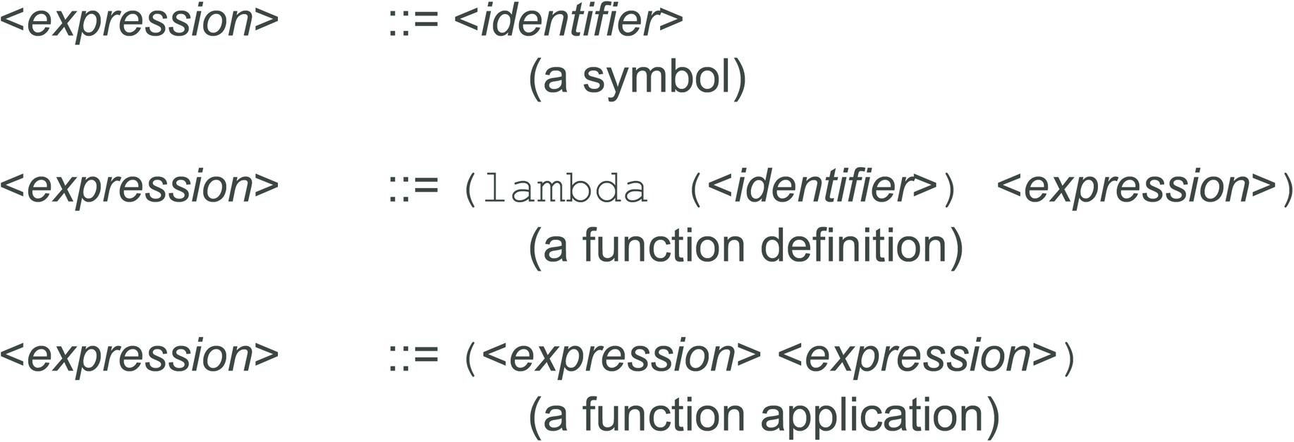
5.2.2 Lambda Calculus

Slide 6
5.3 Lisp
Ideally situated between formal mathematics and natural language (Friedman and Felleisen 1996b, Preface)
“If you give someone Fortran, he has Fortran. If you give someone Lisp, he has any language he pleases” (Friedman and Felleisen 1996b, Afterword).
It is a metalanguage: a language for creating languages (Sussman, Steele, and Gabriel 1993).
Lisp is the second oldest programming language. (Which is the oldest?)
The Lisp interpreter operates as a simple interactive read-eval-print loop (REPL; sometimes called an interactive toplevel).

Slide 7
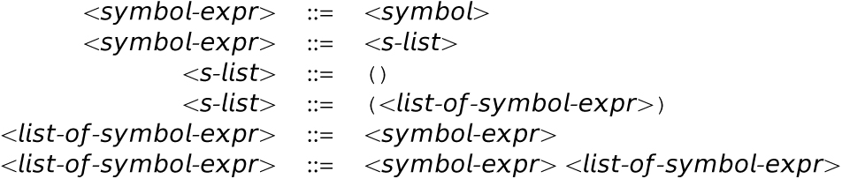
5.3.2 Lists in Lisp (1 of 2)
Lisp syntax (programs or data) is made up of S-expressions (i.e., symbolic expressions).

Slide 8
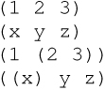
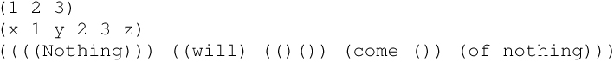
5.3.2 Lists in Lisp (2 of 2)
Examples of Lisp lists, which are also S-expressions:
More examples of S-expressions:

Slide 9
Formal Parameters Vis-à-Vis Actual Parameters
Formal parameters (also known as bound variables or simply parameters) are used in the declaration and definition of a function.
Actual parameters (or arguments) are passed to a function in an invocation of a function.

Slide 10
Review of Recursion
Identify the smallest instance of the problem—the base case—and solve the problem for that case only.
Assume you already have a solution to the penultimate (in size) instance of the problem named n - 1. Do not try to solve the problem for that instance. Remember, you are assuming it is already solved for that instance. Now given the solution for this n - 1 case, extend that solution for the case n. This extension is much easier to conceive than an original solution to the problem for the n - 1 or n cases.
See Design Guideline 1: General Pattern of Recursion in Table 5.7

Slide 11
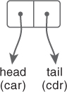
Figure 5.1 List Box Representation of a Cons Cell
The cdr is a pointer to the tail of the list as a list.
The car is a pointer to the head of the list as an atom or a list.
In Racket, there are equivalent functions (first L) and (rest L)

Slide 12
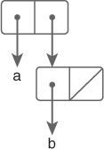
Figure 5.2'(a b) = '(a . (b))

Slide 13
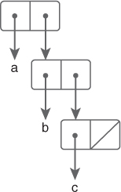
Figure 5.3'(a b c) = '(a . (b c)) = '(a . (b . (c)))

Slide 14
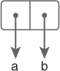
Figure 5.4 '(a . b)

Slide 15
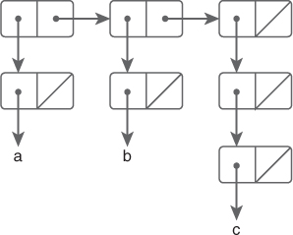
Figure 5.5 '((a) (b) ((c))) = ' ((a) . ((b) ((c)))) = ' ((a) . ((b) . (((c)))))

Slide 16
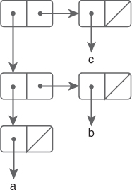
Figure 5.6 '(((a) b) c)

Slide 17
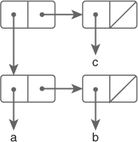
Figure 5.7 '((a b) c) = ' (((a) b) . (c)) = ' (((a) . (b)) . (c))

Slide 18
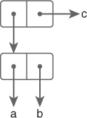
Figure 5.8 '((a . b) . c)

Slide 19
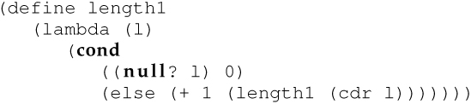
5.6.1 A List length1 Function
length: given a list, returns the length of the list:
Built-in Scheme predicate null? returns #t if its argument is an empty list and #f otherwise.
Editorial note: Any length function requires linear time (each item must be counted). This version also requires linear space.

Slide 20
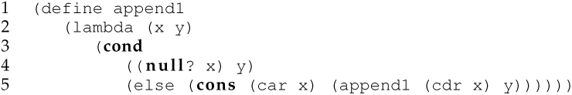
5.6.2 Run-Time Complexity: append and reverse (1 of 4)
Built-in Scheme function append:
The run-time complexity of append is linear [or O(n)] in the size of the first list.

Slide 21
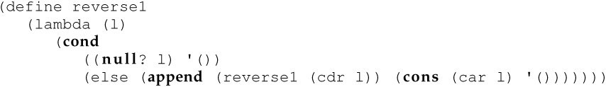
5.6.2 Run-Time Complexity: append and reverse (2 of 4)
While the running time of append is not constant like that of cons, it is also not polynomial [e.g., O(n²)].
However, the effect of the less efficient append function is compounded in functions that use append where the use of cons would otherwise suffice.
The reverse function accepts a list and returns the list reversed:
Scheme uses pass-by-value parameter passing.
Notice that reverse1 can reverse a list of employee records or pixels, or reverse a list involving a combination of multiple types.
It can even reverse a list of lists.

Slide 22
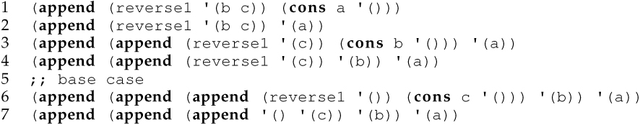
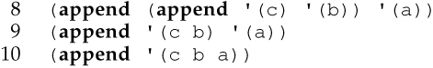
5.6.2 Run-Time Complexity: append and reverse (3 of 4)
This expansion illustrates how, in reversing the list (a b c), the expression in the else clause is expanded:
As this expansion illustrates, reversing a list of n items requires n-1 calls to append.
The running time of append is linear, O(n).

Slide 23
5.6.2 Run-Time Complexity: append and reverse (4 of 4)
But the run-time complexity of this definition of reverse1 is O(n²), which is unsettling.
Intuitively, to reverse a list, we need pass through it only once; thus, the upper bound on the running time should be no worse than O(n).
The difference in running time between cons and append is magnified when append is employed in a function like reverse1, where cons would suffice.
Design Guideline 3: Efficient List Construction: never use append where cons will suffice

Slide 24
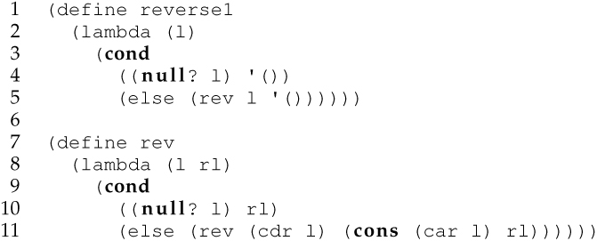
5.6.3 The Difference Lists Technique (1 of 2)
Without side effects, which are contrary to the spirit of functional programming, the only ways for successive calls to a recursive function to share and communicate data is through return values (as is the case in the reverse1 function) or parameters.
The difference lists technique involves using an additional parameter that represents the solution (e.g., the reversed list) computed thus far.

Slide 25
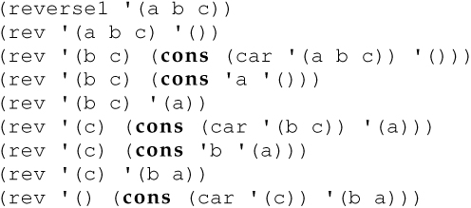
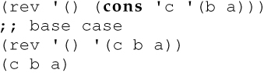
5.6.3 The Difference Lists Technique (2 of 2)
Conducting a similar run-time analysis of this version of reverse1 as we did with the prior version, we see:
Now the running time of the function is linear [i.e., O(n)] in the size of the list to be reversed.

Slide 26
Outline
5.1 Chapter Objectives
5.2 Introduction to Functional Programming
5.3 Lisp
5.4 Scheme
5.5 cons Cells: Building Blocks of Dynamic Memory Structures
5.6 Functions on Lists
5.7 Constructing Additional Data Structures
5.8 Scheme Predicates as Recursive-Descent Parsers
5.9 Local Binding: let, let*, and letrec
5.10 Advanced Techniques
5.11 Languages and Software Engineering
5.12 Layers of Functional Programming
5.13 Concurrency
5.15 Thematic Takeaways

Slide 27
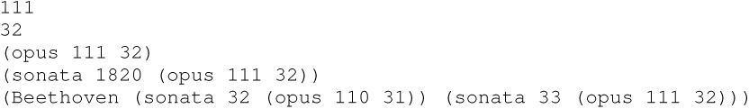
5.7.1 A Binary Tree Abstraction (1 of 3)
Consider the following BNF specification of a binary tree:
The following sentences in the language defined by this grammar represent binary trees:

Slide 28
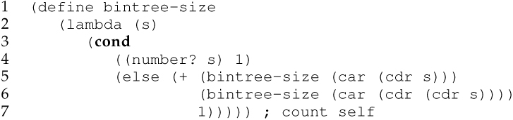
5.7.1 A Binary Tree Abstraction (2 of 3)
The following function accepts a binary tree as an argument and returns the number of internal and leaf nodes in the tree:

Slide 29
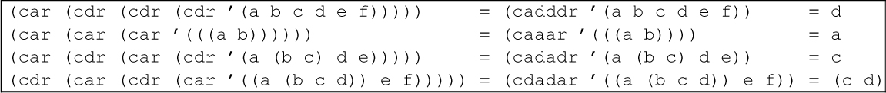
Table 5.1 Examples of Shortening car-cdr Call Chains with Syntactic Sugar
Note that Racket has functions (first L), (second L), (third L), etc., through (tenth L).
It also has (take L n), to return the first n elements of L, and (drop L n), which returns list L with the first n items removed.
In general, (list-ref L pos) returns the item at position pos.
And (list-tail L pos) returns the remainder of the list after the first pos elements

Slide 30
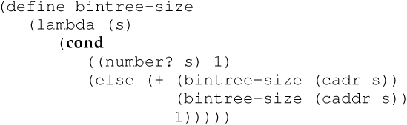
5.7.1 A Binary Tree Abstraction (3 of 3)
Thus, we can rewrite bintree-size as follows:
Exercise: Rewrite using Racket idiom (first, second, etc)

Slide 31
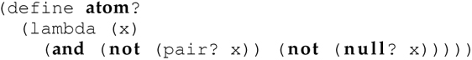
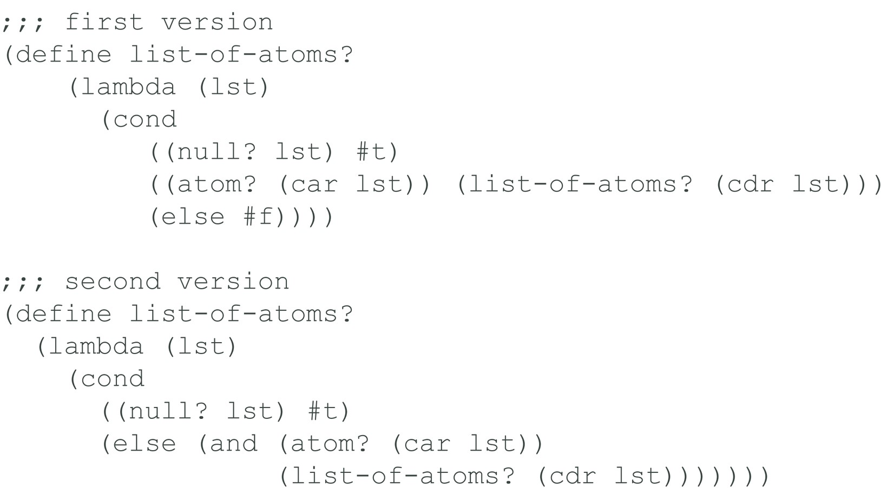
5.8.1 atom?, list-of-atoms?, and list-of-numbers? (1 of 4)

Slide 32
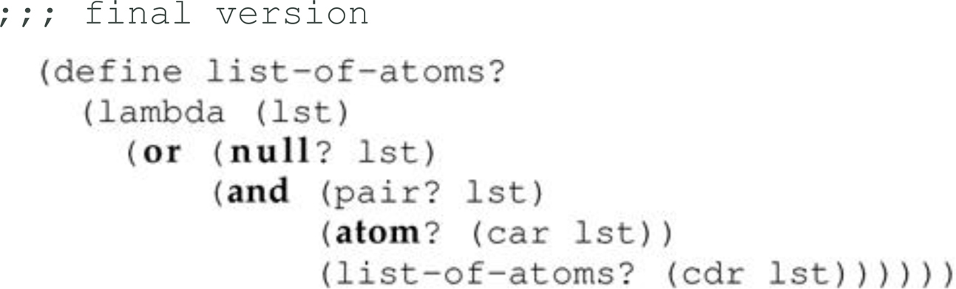
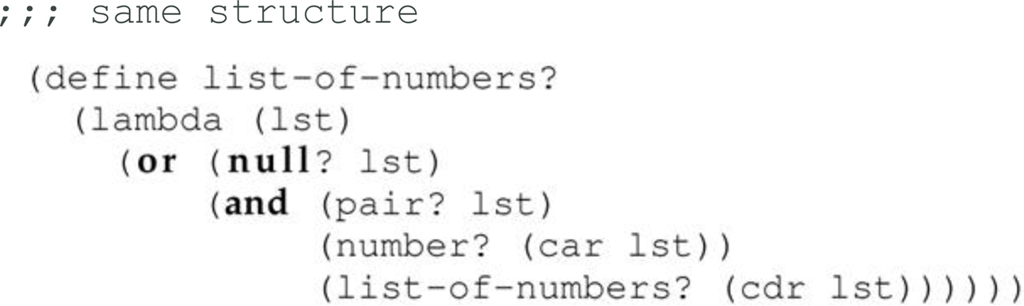
5.8.1 atom?, list-of-atoms?, and list-of-numbers? (2 of 4)

Slide 33
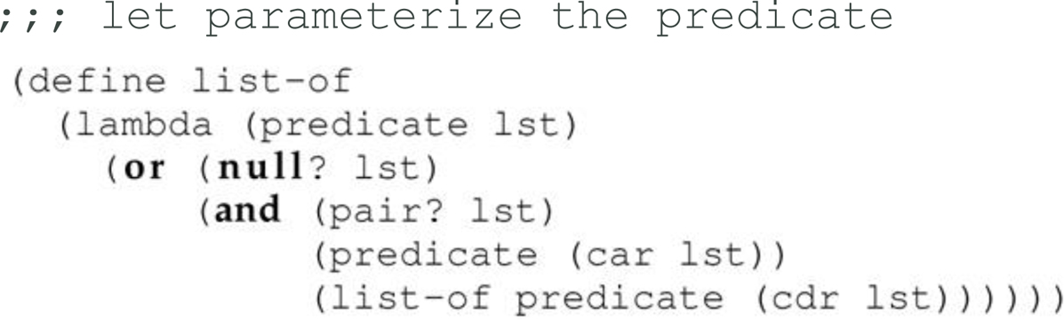
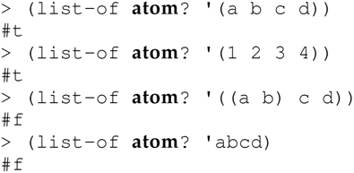
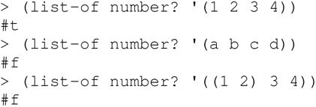
5.8.1 atom?, list-of-atoms?, and list-of-numbers? (3 of 4)

Slide 34
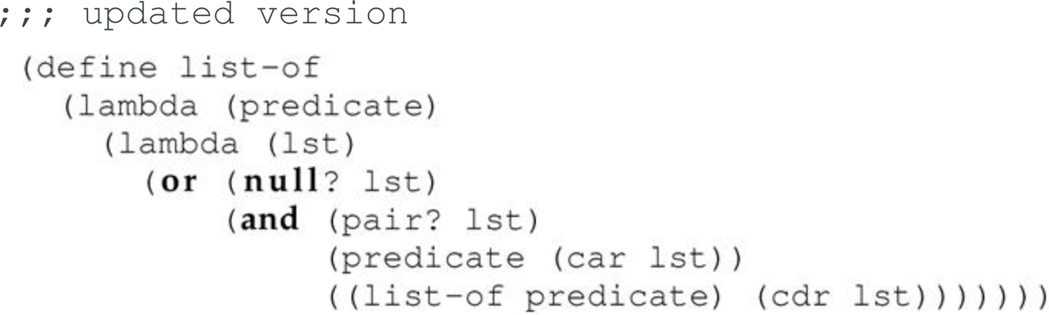
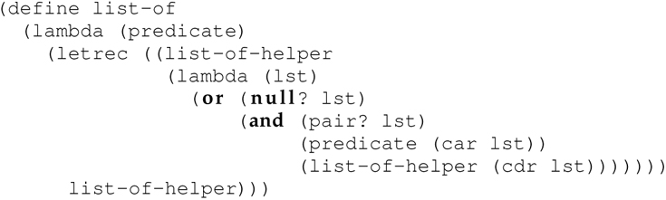
5.8.1 atom?, list-of-atoms?, and list-of-numbers? (4 of 4)

Slide 35
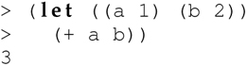
5.9.1 The let Expression
Local binding through the let construct:
Bindings are created in parallel in the list of lists immediately following let
[e.g., ((a 1) (b 2))]
and are only bound during the evaluation of the second S-expression
[e.g., (+ a b)].
Use of let does not violate the spirit of functional programming for two reasons:
(1) let creates bindings, not assignments
(2) let is syntactic sugar used to improve the readability of a program
Any let expression can be rewritten as an equivalent lambda expression.

Slide 36
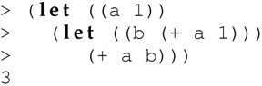
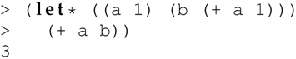
The let* Expression
We can produce sequential evaluation of the bindings by nesting lets:
A let* expression is syntactic sugar for this idiom, in which bindings are evaluated in sequence:

Slide 37
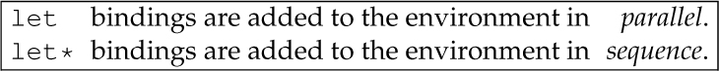
Table 5.2 Binding Approaches Used in let and let* Expressions

Slide 38
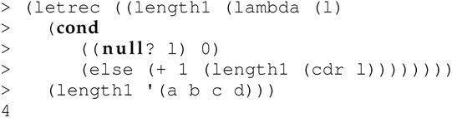
5.9.2 The letrec Expression
Use the letrec expression to make bindings visible while they are being created:

Slide 39
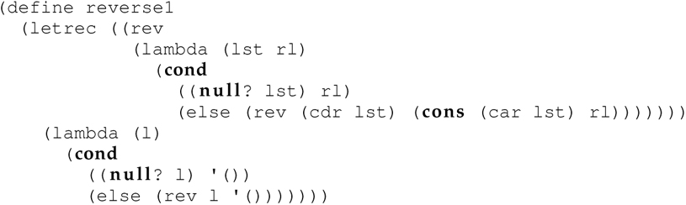
5.9.3 Using let and letrec to Define a Local Function (1 of 2)
Design Guideline 5: Nest Local Functions

Slide 40
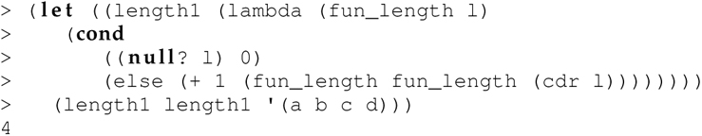
Recursion from First Principles
Both let* and letrec are syntactic sugar for let.
Both let* and letrec are syntactic sugar for lambda (through let).
Reduce the preceding letrec expression for length1 to a let expression.
Functions only know about what is passed to them, and what is in their local environment.
We need length1 to know about itself—so it can call itself recursively.
Thus, we pass length1 to length1 itself!

Slide 41
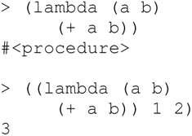
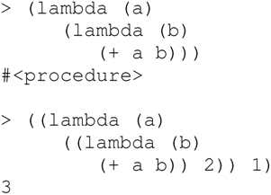
5.9.3 Using let and letrec to Define a Local Function (2 of 2)
Any function accepting more than one argument can be rewritten as an expression in λ-calculus by nesting λ-expressions.
The function definition and invocation
can be rewritten as:

Slide 42
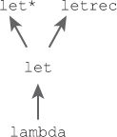
Figure 5.9 Graphical Depiction of the Foundational Nature of lambda

Slide 43
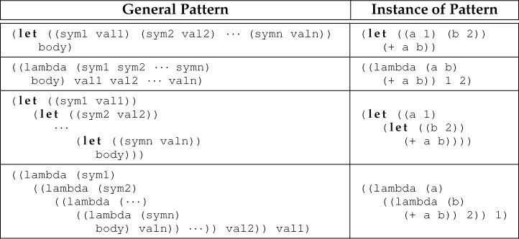
Table 5.3 Reducing let to lambda (All rows of each column are semantically equivalent.)

Slide 44
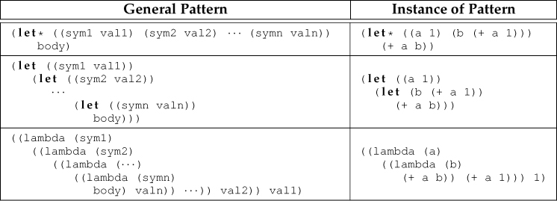
Table 5.4 Reducing let* to lambda (All rows of each column are semantically equivalent.)

Slide 45
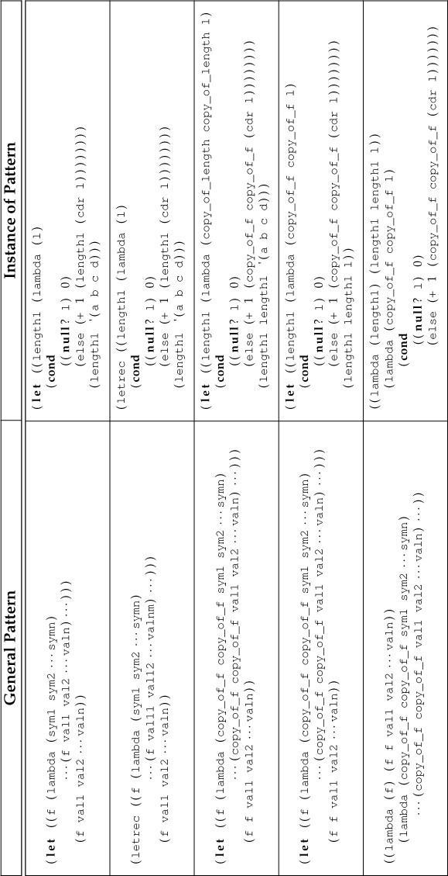
Table 5.5 Reducing letrec to lambda (All rows of each column are semantically equivalent.)

Slide 46
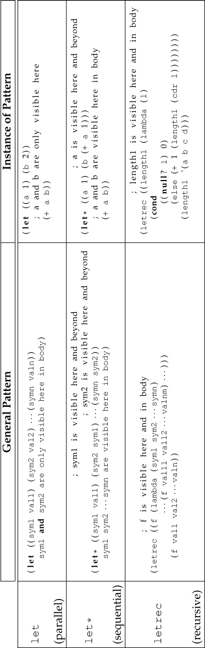
Table 5.6 Semantics of let, let*, and letrec

Slide 47
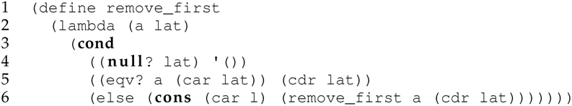
5.10.1 More List Functions (remove_first)
The function remove_first removes the first occurrence of an atom a from a list of atoms lat:
Note typo: Last line should be (else (cons (car lat) (remove_first a (cdr lat)))))))

Slide 48
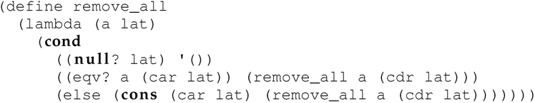
5.10.1 More List Functions (remove_all)
remove_all extends remove_first by removing all occurrences of an atom a from a list of atoms lat by returning (remove_all (cdr lat)) in line 5 rather than (cdr lat):

Slide 49

5.10.1 More List Functions (remove_all*)
Extend remove_all so that it removes all occurrences of an atom a from any S-list, not just a list of atoms.
Using the third pattern in Design Guideline 2: Specific Patterns of Recursion results in:

Slide 50
5.10.2 Eliminating Expression Recomputation
Functional programs usually run more slowly than imperative programs because
(1) they are typically interpreted;
(2) they use recursion which is slower than iteration due to the overhead of the run-time stack; and
(3) the pass-by-value parameter-passing mechanism is inefficient.
Barring interpretation and recursion, recomputing expressions only makes the program slower.
Design Guideline 4: Name Recomputed Subexpressions

Slide 51

New Version of remove_all*
Notice that binding the result of the evaluation of the expression (cdr l) to the mnemonic tail, while improving readability, does not actually improve performance. While the expression (cdr l) appears more than once in this definition (lines 9, 10, and 12), it is computed only once per function invocation.

Slide 52

Newer Version of remove_all*
Passing an argument with the same value across multiple recursive calls is inefficient and unnecessary.
Every time remove_all* is called, it is passed the atom a, which never changes.
Design Guideline 6: Factor out Constant Parameters
This version of remove_all* works because within the scope of remove_all* (lines 3–22), the parameter a is visible.
We can think of it as global just within that block of code.
Since it is visible in that range, it need not be passed to any function defined (either with a let, let*, or letrec expression) in that block, since any function defined within that scope already has access to it.
We defined a nested function remove_all_helper* that accepts only a list l as an argument.
The parameter a is not passed to remove_all_helper* in the calls to it on lines 12, 15, and 18–20 (only a smaller list is passed), even though within the body of remove_all_helper* the parameter a (from the function remove_all*) is referenced.

Slide 53


5.10.3 Avoiding Repassing Constant Arguments Across Recursive Calls (1 of 2)
If the nested function f must access one or more of the parameters (i.e., Design Guideline 6), which is the case with remove_all*, then the style illustrated in lines 1–11 must be used.
Conversely, if one or more of the parameters to the outer function should be hidden from the nested function, which is the case with reverse1, then the style used on lines 13–28 must be used.

Slide 54


5.10.3 Avoiding Repassing Constant Arguments Across Recursive Calls (2 of 2)
Consider the following two letrec expressions, both of which yield the same result:
They are functionally equivalent.
The first expression (lines 1–5) calls the local function length1 in the body of the letrec (line 5).
The second expression (lines 8–12) first returns the local function length1 in the body of the letrec (line 12) and then calls it—notice the double parentheses to the left of letrec on line 8.
The first expression uses binding to invoke the function length1.
The second uses binding to return the function length1.

Slide 55
Outline
5.1 Chapter Objectives
5.2 Introduction to Functional Programming
5.3 Lisp
5.4 Scheme
5.5 cons Cells: Building Blocks of Dynamic Memory Structures
5.6 Functions on Lists
5.7 Constructing Additional Data Structures
5.8 Scheme Predicates as Recursive-Descent Parsers
5.9 Local Binding: let, let*, and letrec
5.10 Advanced Techniques
5.11 Languages and Software Engineering
5.12 Layers of Functional Programming
5.13 Concurrency
5.15 Thematic Takeaways

Slide 56
5.11 Languages and Software Engineering
Programming languages that support
the construction of abstractions, and
ease of program modification
also support
ongoing development of a malleable program design, and
the evolution of a prototype into product.

Slide 57
5.11.2 Language Flexibility Supports Program Modification
A functional style of programming in a flexible language supports ease of program modification.
We not only organically constructed the functions and programs here, but also refined them repeatedly with ease.
The interactive read-eval-print loop used in interpreted languages fosters rapid program development, modification, testing, and debugging.
In contrast, programming in a compiled language such as C++ involves the use of a program-compile-debug-recompile loop.
The ability to make more global changes to a program easily is especially important—evolving specifications is a reality.
A language should facilitate, and not handicap, an (inevitable) evolving design and redesign.

Slide 58

Figure 5.10 Layers of Functional Programming

Slide 59
5.15 Thematic Takeaways
Functional programming unites beauty with utility.
The λ-calculus, and the three grammar rules that constitute it, are sufficiently powerful.
An important theme in a course on data structures and algorithms is that data structures and algorithms are natural reflections of each other.
Powerful programming abstractions can be constructed in a few lines of Scheme code.
Recursion can be built into any programming language with support for first-class anonymous functions.
Speed of development is now a more important criterion in the creation of software than it has been historically

Slide 60

Table 5.7 Functional Programming Design Guidelines

Slide 61
Additional Functional Programming Design Guidelines
Scott Wlaschin suggests the following functional design principles:
Composition Everywhere! Use functions as building blocks, using the output of one function as input to the next. Design them so you can snap them together like Legos.
Strive for Totality! Your function should do something ‘sensible’ for any valid input. If your numeric function crashes if passed a zero, either modify it to do something sensible (use Maybe or Either, perhaps), or document that the parameter must be nonzero—it’s up to the caller to check that it’s valid.
Don’t Repeat Yourself! If different functions are doing almost-but-not-quite the same thing, factor out the common part, and use subfunctions or helper functions as needed.
Parameterize the things! Generalize your functions by adding parameters. A sorting function that can take in any comparison method is more useful than one locked in to using <.
The Hollywood Principle (Don’t call us, we’ll call you). Provide callback functions so you can use partial application to customize a generic function.
Notes:
Wlaschin, S. Functional Design Patterns. NDC Sydney 2017, Aug 14-18 2017, Sydney Australia. Video at https://www.youtube.com/watch?v=srQt1NAHYC0, viewed 5/15/22.

